Slide 1
Intro to AI with Semantic Search Project
Learn the principles of AI & ML with a noob-friendly semantic search project!
Kyle Hoang | Ignite IT Digital Rotational Program
March 28th , 2026

Slide 2


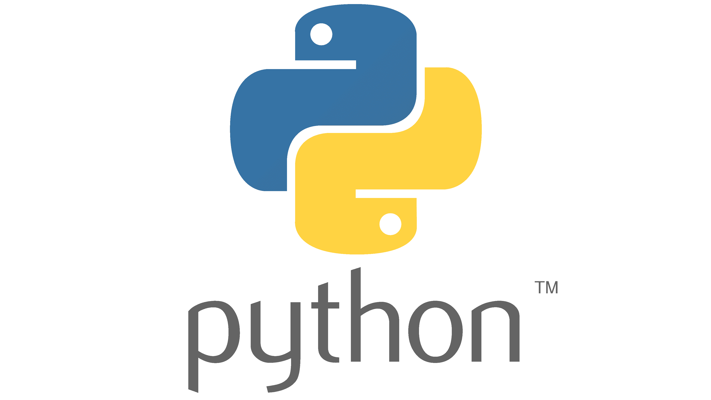
Goals of this workshop
AI/ML Basics Crash Course:
What is artificial intelligence and machine learning?
What are transformers and embeddings?
What is BERT and vector databases?
Semantic Search Project
Guided hands-on creation of your own AI-powered semantic search application
Requirements
A computer with Python and VSCode
Or a fork like Windsurf
A present for me
Just kidding

Slide 3
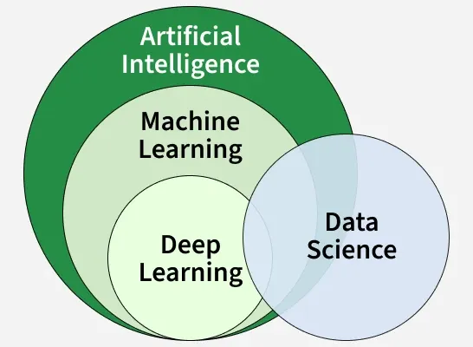
AI/ML Basics: What is artificial intelligence and machine learning?
What is Artificial Intelligence (AI)?
Ability for computers to imitate cognitive human functions such as learning and problem-solving.
Math and logic to simulate REASONING to learn from new information and make decisions.
In tech we think of systems capable of problem-solving, reasoning, adapting, and generalized learning.
What is Machine Learning (ML)?
Teaching computers to:
Extract patterns from collected data
Apply them to new tasks.
Subset of AI.
ML studies patterns on data which data scientists use to improve AI.
https://www.youtube.com/watch?v=aircAruvnKk

Slide 4
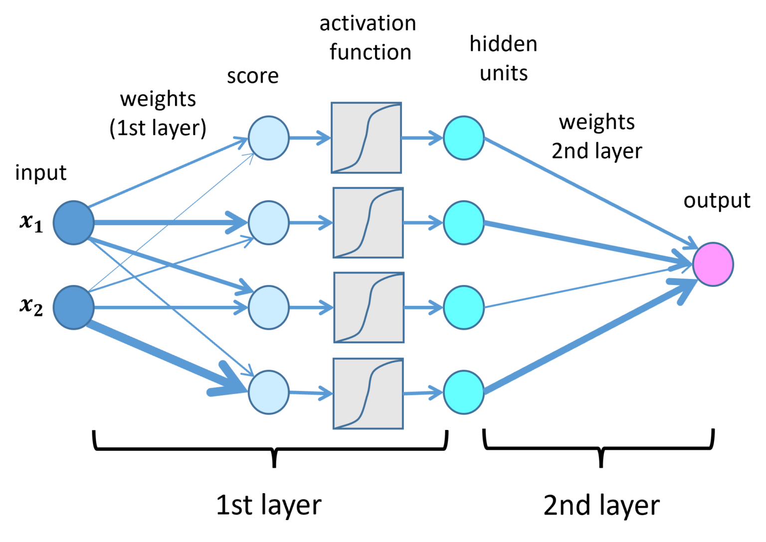
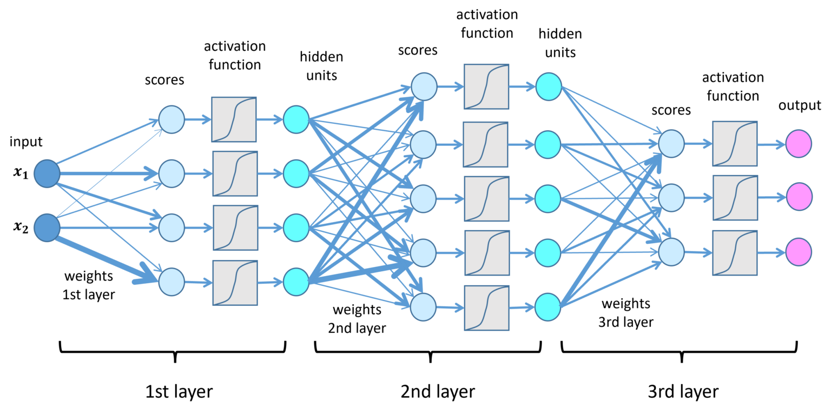
What is Deep Learning? Neural Networks?
Modern machine learning is built on neural networks.
Neural networks is a subset of ML
The foundation for Deep Learning.
In neural network we assign weights to nodes.
The output of a neural network is a sum of an input multiplied by the weights of the node which will map to a certain output.
What differentiates deep learning from traditional machine learning:
Lack of necessity for human supervision
Number of layers of neural networks
https://lamarr-institute.org/blog/deep-neural-networks/

Slide 5
What are transformers?
Type of neural network with specific architecture that is dominant in modern machine learning
Excel at NLP, translation, vision, audio, image generation, etc.
The “T” in GPT (Generative Pre-Trained Transformer)
Successor to:
Recurrent Neural Networks (RNNs)
Convolutional Neural Networks (CNNs)
These NNs processed data in a serially
Hindered the ability to capture long-range dependencies in NLP.
The Big Cheese: Self-attention mechanism
Contains self-attention mechanism where it focuses on all parts of the input simultaneously.
Make decisions about how and when to focus on specific time steps of that sequence which
improves its ability to understand long-range dependencies and allowing for parallelization.
Transformers can take full advantage of GPUs during training since GPUs are designed to excel at parallel workflows.
More power = larger datasets!
https://www.youtube.com/watch?v=wjZofJX0v4M

Slide 6
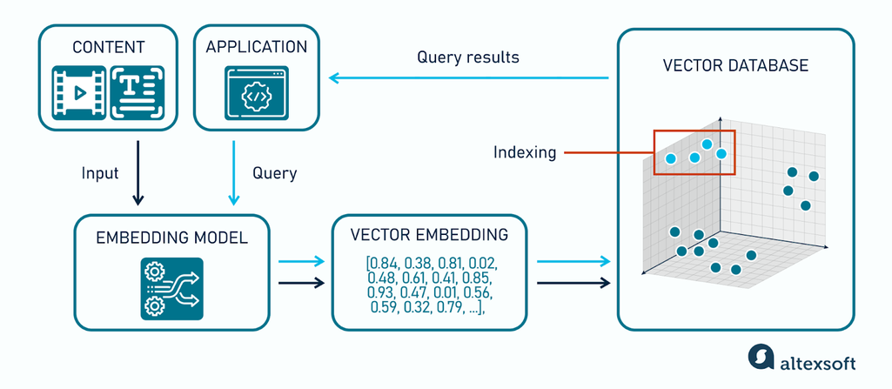
BERT
BERT = Bidirectional Encoder Representations from Transformers
Transformer model that uses only the encoder portion of transformer architecture.
Developed by Google
The backbone of modern enterprise search, especially when integrated with RAG.
Integrated into Google Search in 2019.
Trained to understand text rather than generate it
BERT reads in both directions simultaneously using Masked Language Modeling (MLM)
During training, random tokens are masked and model is tasked to predict them using context from both sides
BERT has a richer, more contextual understanding of meaning.

Slide 7
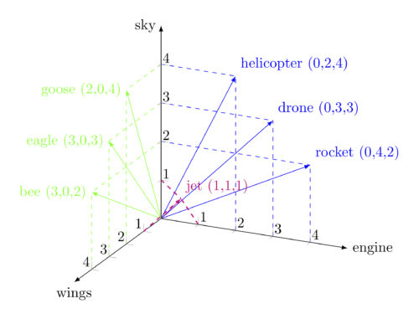
BERT + Semantic Search
Classic keyword search tries to match exact terms.
Semantic search seeks to understand intent and meaning by converting text into dense vector embeddings which are numerical representations of the input.
E.g., car and automobile would end up close in a vector space
A query like "how do I fix low voltage" can match a document about "troubleshooting power drops" without shared keywords
Encode query → embedding vector
Encode documents → embedding vectors
Retrieve by cosine similarity rather than keyword overlap
https://corpling.hypotheses.org/495

Slide 8

https://github.com/kylehoahoang/anime-semantic-search

